Slide 1
Family Assessment in Psychiatry
Prof. K.A.L.A.Kuruppuarachchi
MD(Psych), FRCPsych(UK),FSLCOP
Senior Professor of Psychiatry
University of Kelaniya

Slide 2

FAMILIES
Role of the family
Definition of the family
Nature of families

Slide 3
Definition of the Family
A group of people –united by ties of blood, marriage or adoption; who form a single household; in which they perform their respective roles of husband and wife, son and daughter, mother and father, brother and sister; creating a common culture
(North, 1980)

Slide 4
Classification of Families
Extended Families
Nuclear Families
Transition of family structure in different cultures/countries

Slide 5
Family and coping
Adaptation in adversity and coping
in stressful situations
Negative outcome
Positive outcome
Family
Relationships
Personality/Coping skills

Slide 6
Advantages of our families
Caring
Warmth
Access to other members in adversity/stressful situations
Problems
Over involvement

Slide 7
Problems in families
Overinvolved families
Critical families
Hostile families/relationships
Distant relationships and neglect
Abusive families
Scapegoating

Slide 8
Childhood and mental health
Subsequent Psychological
health in adulthood
Childhood adversities
Childhood environment
Mental Health in childhood

Slide 9
Multifactorial causation of childhood mental disorders
Gene- Environment correlation and interaction
Psychosocial adversity and child Psycho pathology
Childhood adversities and subsequent adult mental health

Slide 10
Additive nature of vulnerability factors
e.g. domestic violence, alcoholic parents, neglect, child abuse , problematic institutional care, separation , parental mental illness
Protective Factors
e.g. caring , warm , stable families

Slide 11
Multiple forms of childhood maltreatment
e.g. Sexual abuse
Physical abuse, Emotional abuse and neglect
Witnessing maternal violence
Adversely influence adult mental health

Slide 12


Slide 13
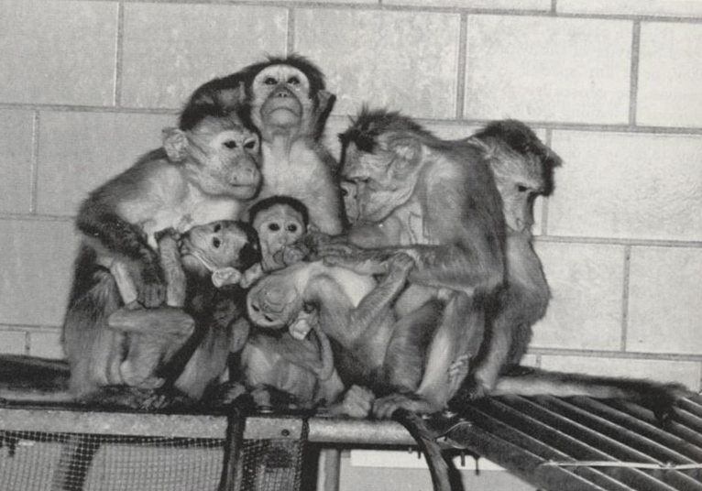
Family relationships

Slide 14
Childhood adversities and Adulthood
Problems with personality development
Antisocial behavior
Poor relationships
Problems with impulse control
Other problems
e.g. substance misuse, mood disorders , deliberate self harm etc.

Slide 15
Importance of identification of them in preventive programmes
Biological factors
Psychosocial factors
maternal depression
Institutionalization
Exposure to violence
Poor cognitive stimulation
Developing brain

Slide 16
Family therapy
Assessment of families
Identifying protective and vulnerability factors
Identifying the relationship of psychopathology and family dynamics
Helping to solve unhealthy family relationships and strengthening the desired/adaptive ways of coping and relationships
Applicable to some adulthood problems also

Slide 17
Maladaptive parenting
Child self control
Need to target both parents/children simultaneously in intervention programmes

Slide 18
Our Traditional Protective Factors
Our caring, warm families
Religious upbringing
CONCLUSIONS:
Nature or Nurture – Genetic and environmental interaction
Needs to identify the protective and vulnerability factors in preventive programmes.
Be aware of multiple and additive nature of the vulnerability factors

Slide 19
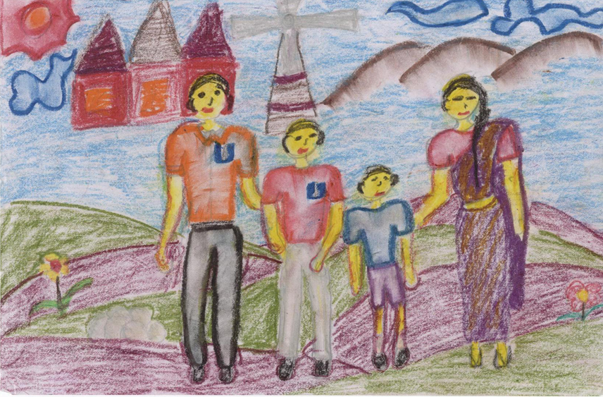
Drawings of a happy child

